Slide 1
DATE
Taxes 101
Don’t Leave Money on the Table!
Notes:
Welcome and thank you for providing this workshop to the young adults you work with! A few things to know before getting started:
The workshop will take about 90 minutes, depending on how much engagement/discussion you include. You can cover the material in one session or over two days, depending on your scheduling and your audience’s attention span.
We recommend making the workshop as interactive as possible, taking questions throughout, and pausing at the end of each section to reinforce learning. One option is to ask two “quiz” questions based on what they’ve learned.
All the resources referenced or linked to can be found here: https://jbay.org/resources/tax-filing-tax-credits-informational-resources/

Slide 2
Agenda
Introductions and Ice Breaker
What Are Taxes, Why Should I File Them, and When?
What Are Tax Credits?
How Do I Prepare to File My Taxes?
How Do I File My Taxes?
What Happens After I File My Taxes?

Slide 3
Introductions & Ice Breaker
Have You Ever Filed Your Taxes?
Notes:
Facilitators introduce themselves
Ice Breaker: Ask the participants to introduce themselves, and share whether they’ve ever filed their taxes.
If yes, what was that experience like? If no, do you have any worries about filing for the first time?

Slide 4
What Are Taxes?
Why Should I File Them?
When Should I File Them?
Notes:
.

Slide 5
What Exactly Are Taxes?
Taxes provide revenue for federal, local, and state governments to fund:
Essential services intended to benefit all citizens
E.g. defense, highways, police, a justice system
Programs and services that benefit certain citizens
E.g. health, welfare, social services, job training, schools, parks
Notes:
Intro:
There is sales tax on things we buy; property taxes if we own a home; and if we work, we pay income taxes.
Taxes pay for things that maintain society

Slide 6
What Are Income Taxes?
Income taxes reduce taxpayers’ income.
The rate at which people are taxed (your “tax bracket”) depends on how much money they make.
Usually higher-income taxpayers pay a higher rate of income tax than lower-income taxpayers.
The amount of money withheld from each paycheck determines whether you owe money or you are owed money at the end of the year, and how much.
This is why the information you provide on your W-4 when you start a job, is so important!
Notes:
Intro:
Today we’re going to talk about income taxes because these are the taxes people “file” each year.
Everyone needs to learn about taxes and how to file them because even if you choose not to file now, once you make a certain amount of money, you will be REQUIRED to file each year or you can get in trouble with the Internal Revenue Service (IRS).
Other Points to Make After Covering Slide Content:
Most of you will not owe taxes; you will get a refund. In 2023, just 7% of current and former foster youth ages 18-25 who filed with a tax assistance site for foster youth, owed federal or state taxes.

Slide 7
Why Should I File Taxes?
In 2023, current & former foster youth ages 18-25 who filed received an average of:
$1,906 cash back for single filers
$5,343 cash back for parenting filers!
You may receive money back from tax credits
Tax filing is how you access state or federal relief
Simplifies access to student financial aid
Important independent living skill
Does not impact eligibility for mainstream public benefit programs
Establishes official income for the determination of public benefits
Notes:
Notes on Each Reason to Share with Group:
1. You may receive money back from tax credits: Tax filing is the means to access a wide range of programs to assist low-income individuals, including the state and federal earned income tax credits, the state renter’s credit, the American Opportunity Tax Credit for college students, the state and federal child tax credits, and childcare and dependent expenses credits. There is also now a tax credit specifically for current and former foster youth. In 2023, on average, single youth who filed at foster youth-specific tax assistance sites received back an average of $1,906, and parenting youth an average of $5,343!
2. Tax filing is how you access state or federal relief: In addition to these permanent tax credit programs, tax filing is also the means to access pandemic related relief provided to lower income residents, including the Golden State Stimulus and the federal Economic Impact Payments. A 2021 report found that 60% of current and former foster youth had not received these relief payments because they had not filed their taxes. Filing your taxes ensures that you receive the full range of ongoing state and federal income support programs as well as one-time benefit programs, such as those provided during the pandemic.
3. Simplifies access to student financial aid: All recipients of student financial aid are required to provide their tax return or provide an IRS Verification of Non-filing Letter. Financial aid is not distributed to the student until this verification is completed. For foster youth who don’t file their taxes, the process of obtaining the required documentation is difficult because they are not able to complete the process online. The online process requires a credit card, mortgage, home equity loan, home equity line of credit, or car loan, which young adults do not commonly have. Instead, you must complete the paper process, which is time-consuming and error-prone. Filing taxes ensures you have a tax return to provide to receive student financial aid.
4. Does not impact eligibility for mainstream public benefit programs: Recent years have seen a heightened interest in guaranteed income programs, including for current and former foster youth. The income received from these programs can jeopardize eligibility for public benefits, including CalWORKs and subsidized childcare. This is particularly true for federal benefit programs, such as SSI, which require local county child welfare agencies to obtain a federal waiver to exempt income earned through the guaranteed income program. The income gained from tax filing, however, does not pose the same challenge. Public benefit programs have clearly established policies about how to treat income from tax returns, specifically tax credits. Additionally, while many universal basic income programs are in fact not universal, access to tax filing is truly universal for foster youth and is not limited by the level of funding provided or the ability to identify and recruit foster youth.
5. Establishes official income for the determination of public benefits: Public benefit programs, such as CalWORKs, CalFresh and other means-tested programs require an individual to provide their annual income, to determine eligibility. This is challenging when an individual has no proof of annual income. Additionally, receipt of unemployment requires proof of wages. Filing taxes ensures that you can provide documentation of your annual income and gain access to critically needed public benefit programs.
6. Important independent living skill: Through the process of filing taxes, people learn important information about employment practices that they can use to make informed decisions about their employment. For example, young adults who receive self-employment or gig work income will be issued a Form 1099, which provides the amount paid to the individual. No state or federal payroll taxes have been withheld from this income, which often results in a tax liability if the person does not know how to claim qualifying business expenses. Additionally, tax filing is an activity that is conducted throughout the entire working life of an adult, which is on average over 40 years. By filing correctly now, you’re setting yourself up for healthy financial practices long-term.

Slide 8
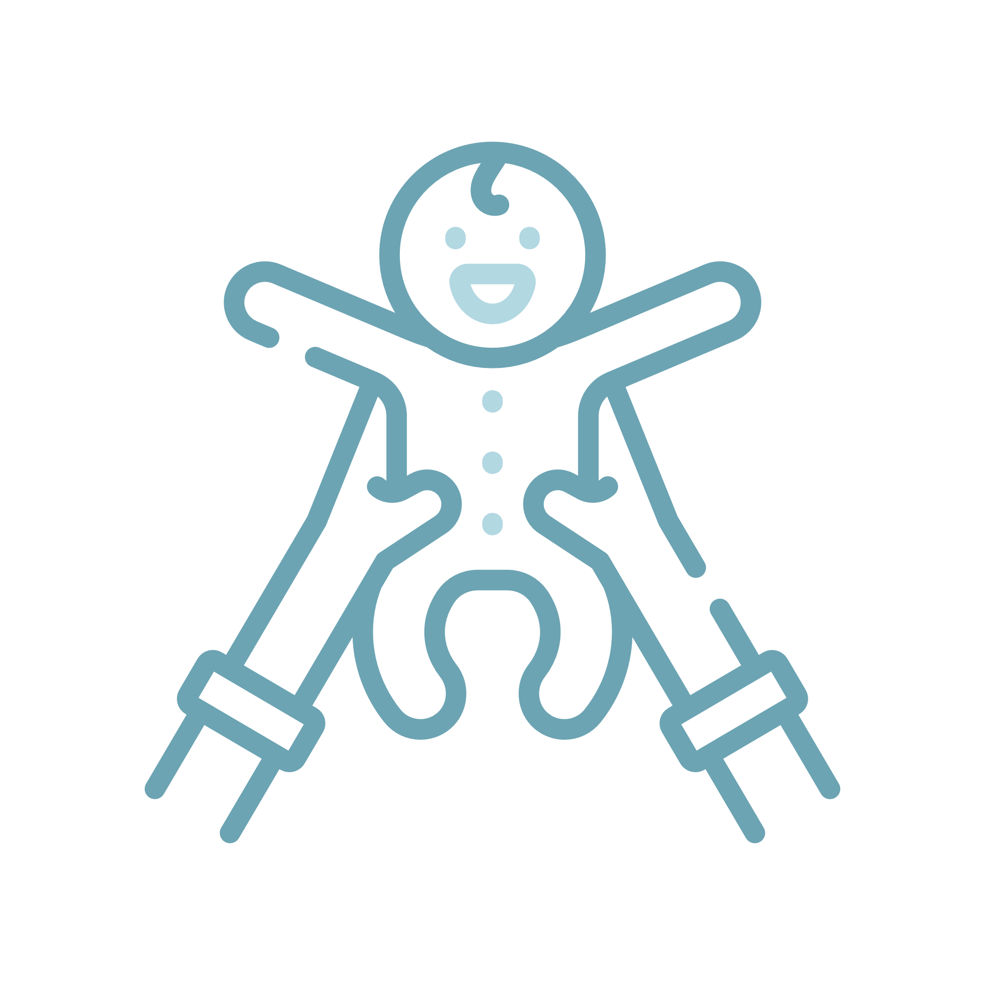
When is a Good Time to Start Filing Taxes?
WHEN YOU GET YOUR FIRST JOB
WHEN YOU HAVE A CHILD
IF YOU’VE MISSED ANY STIMULUS PAYMENTS
Notes:
Additional information for each of the three reasons:
If you earn $1 or more during the tax year, you are eligible for certain credits that provide cash back to you, as long as you don’t earn too much to be eligible. (Its unlikely anyone will have earned too much). If you worked for cash, you can also claim that as earned income. And, if you’ve earned at least $12,950 in the tax year (for single filers under 65), the federal government requires you to file taxes.
If you have a dependent (child), you become eligible for certain credits related to simply having that child or paying for childcare.
If you missed any stimulus payments during the pandemic, you can recover them by filing previous years taxes. NOTE: 2024 is the last tax season to claim stimulus payments.

Slide 9
When is tax season?
January: Tax filing season begins
April: Tax deadline for people who owe taxes
October: Tax deadline for people who do not owe taxes
Notes:
This year the deadline was extended until November 16th.

Slide 10
What Are Tax Credits?

Slide 11
Cash Back Tax Credits Put Money in Your Pocket
A Tax Credit reduces the amount of money you owe the government.
A nonrefundable tax credit does not provide cash back, it just reduces what you owe.
A refundable or “cash back” tax credit reduces what you owe, then once you owe $0, you get to keep whatever is left of the credits. (You get a refund = cash back)
In 2023, 93% of current and former foster youth ages 18-25 owed no taxes. They got to keep their cash back credits!
Notes:
Common questions for this slide:
Why do people owe? Will I owe? Will I get to keep my credits?
Most young adults who owed last year either had:
Self-employment/gig work income which means they didn’t pay taxes during the year because no taxes were taken out of their paychecks, or,
For those not self-employed, they may have not filled out their W-4 correctly and didn’t have enough taxes withdrawn from their paychecks during the year, or,
They may have received a substantial amount of financial aid for college, and used that financial aid for non-qualified expenses, meaning the money was taxable.

Slide 12
New Tax Credit Just for Current & Former Foster Youth!
The California Foster Youth Tax Credit (FYTC)
First of its type in the nation! Became available in 2023. The FYTC is a cash back tax credit.
In 2024, the FYTC will provide up to $1,117 to youth who:
File their 2023 state tax return
Are age 18-25 at end of the tax year (12/31/23)
Were in foster care on or after 13th birthday
Earned between $1 - $30,931 in 2023
Lived in CA at least half of 2023
Download the flyer: https://jbay.org/resources/fytc-flyer/
Notes:
Consider printing out the FYTC flyer and providing to attendees: https://jbay.org/resources/fytc-flyer/
Additional information to share as you see fit or as these questions arise:
Youth who make less than $25K will receive the full credit amount ($1,117). Youth who make between $25K-$30K will receive a lesser amount as the credit starts to phase out once you make $25K.
For undocumented youth, they need an Individual Tax Identification Number (ITIN) to file and receive the FYTC.
For youth to be eligible, their foster care case had to be established in California.
Youth will not qualify if they’re claimed as a dependent on someone else’s tax return (e.g. former foster parent or relative). Its important for youth to communicate with anyone who they suspect might claim them. Someone should not be claiming them unless they supported the youth for at least half of the tax year.

Slide 13
Other Tax Credits You May Be Eligible For
State Tax Credits
California Earned Income Tax Credit (CalEITC)
Young Child Tax Credit (YCTC)
Child & Dependent Care Expenses Credit*
Renters Credit*
Federal Tax Credits
Earned Income Tax Credit (EITC)
Child Tax Credit (CTC)
Child & Dependent Care Tax Credit
American Opportunity Credit and Lifetime Learning Credit*
* The credits with asterisks are not refundable. They will just reduce what you owe, if you owe anything.
Notes:
Notes on Each Credit:
CalEITC: Helps low-income workers and families get a cash refund. Must have earned at least $1 during tax year but not more than $30,950. Credit maximum ranges from $285-$3,529 depending on the number of children you have and your income.
YCTC: Program of the CalEITC. Provides up to $1,117 in 2024. Provided to parents who earn less than $30K and have one or more children who were under age 6 in tax year.
Child & Dependent Care Expenses Credit: You can claim up to $3,000 for one child and $6,000 for more than one child. Children must be under 13 and have lived with you for more than half the tax year. This credit reduces what you owe, but does not provide cash back (non-refundable tax credit).
Renters Credit: If you lived in California for all of the tax year, paid rent for at least half of the tax year, and were not living with a parent or foster parent or legal guardian, you may qualify for the renter’s credit. Its either a nonrefundable $60 credit for single renters whose income is below $49,220, or a nonrefundable $120 credit for married/registered domestic partner taxpayers who file together and whose incomes are below $98,440.
EITC: Helps low to moderate income workers and families get a tax break. If you’re under 25, you have to be parenting, filing as head of household with a qualifying child. Must have income between $1-$59,187. Credit maximum ranges from $560-$6,935, depending on number of children you have and your income.
CTC: For parents – can receive up to $2,000 for each child under age 17. Do not need earned income to qualify.
Child & Dependent Care Credit: For parents who paid expenses for the care of qualifying child to enable you to work or look for work. Qualifying dependent is a child under 13 or a child or other type of dependent of any age who is incapable of self care and who lives with you for more that half the year. Credit is calculated based on income and the percentage of expenses you incur for child care.
American Opportunity Credit: Up to $2,500 per student, calculated as 100% of the first $2,000 in college costs and 25% of the next $2,000. Youth need to save receipts for any qualifying expenses for this credit. That means the funding is not taxable. But if you spend it on nonqualifying expenses it is taxable. This is one of the ways those 7% of youth owed. They got tripped up because they didn’t spend on qualified expenses and didn’t put money away to pay those taxes through the year.
Lifetime Learning Credit: Provides $2,000 for college students who paid for qualified education expenses.

Slide 14
How Do I Prepare to File My Taxes?
Notes:
Consider printing out the Tax Prep Checklist and providing to attendees: https://jbay.org/resources/tax-prep/

Slide 15
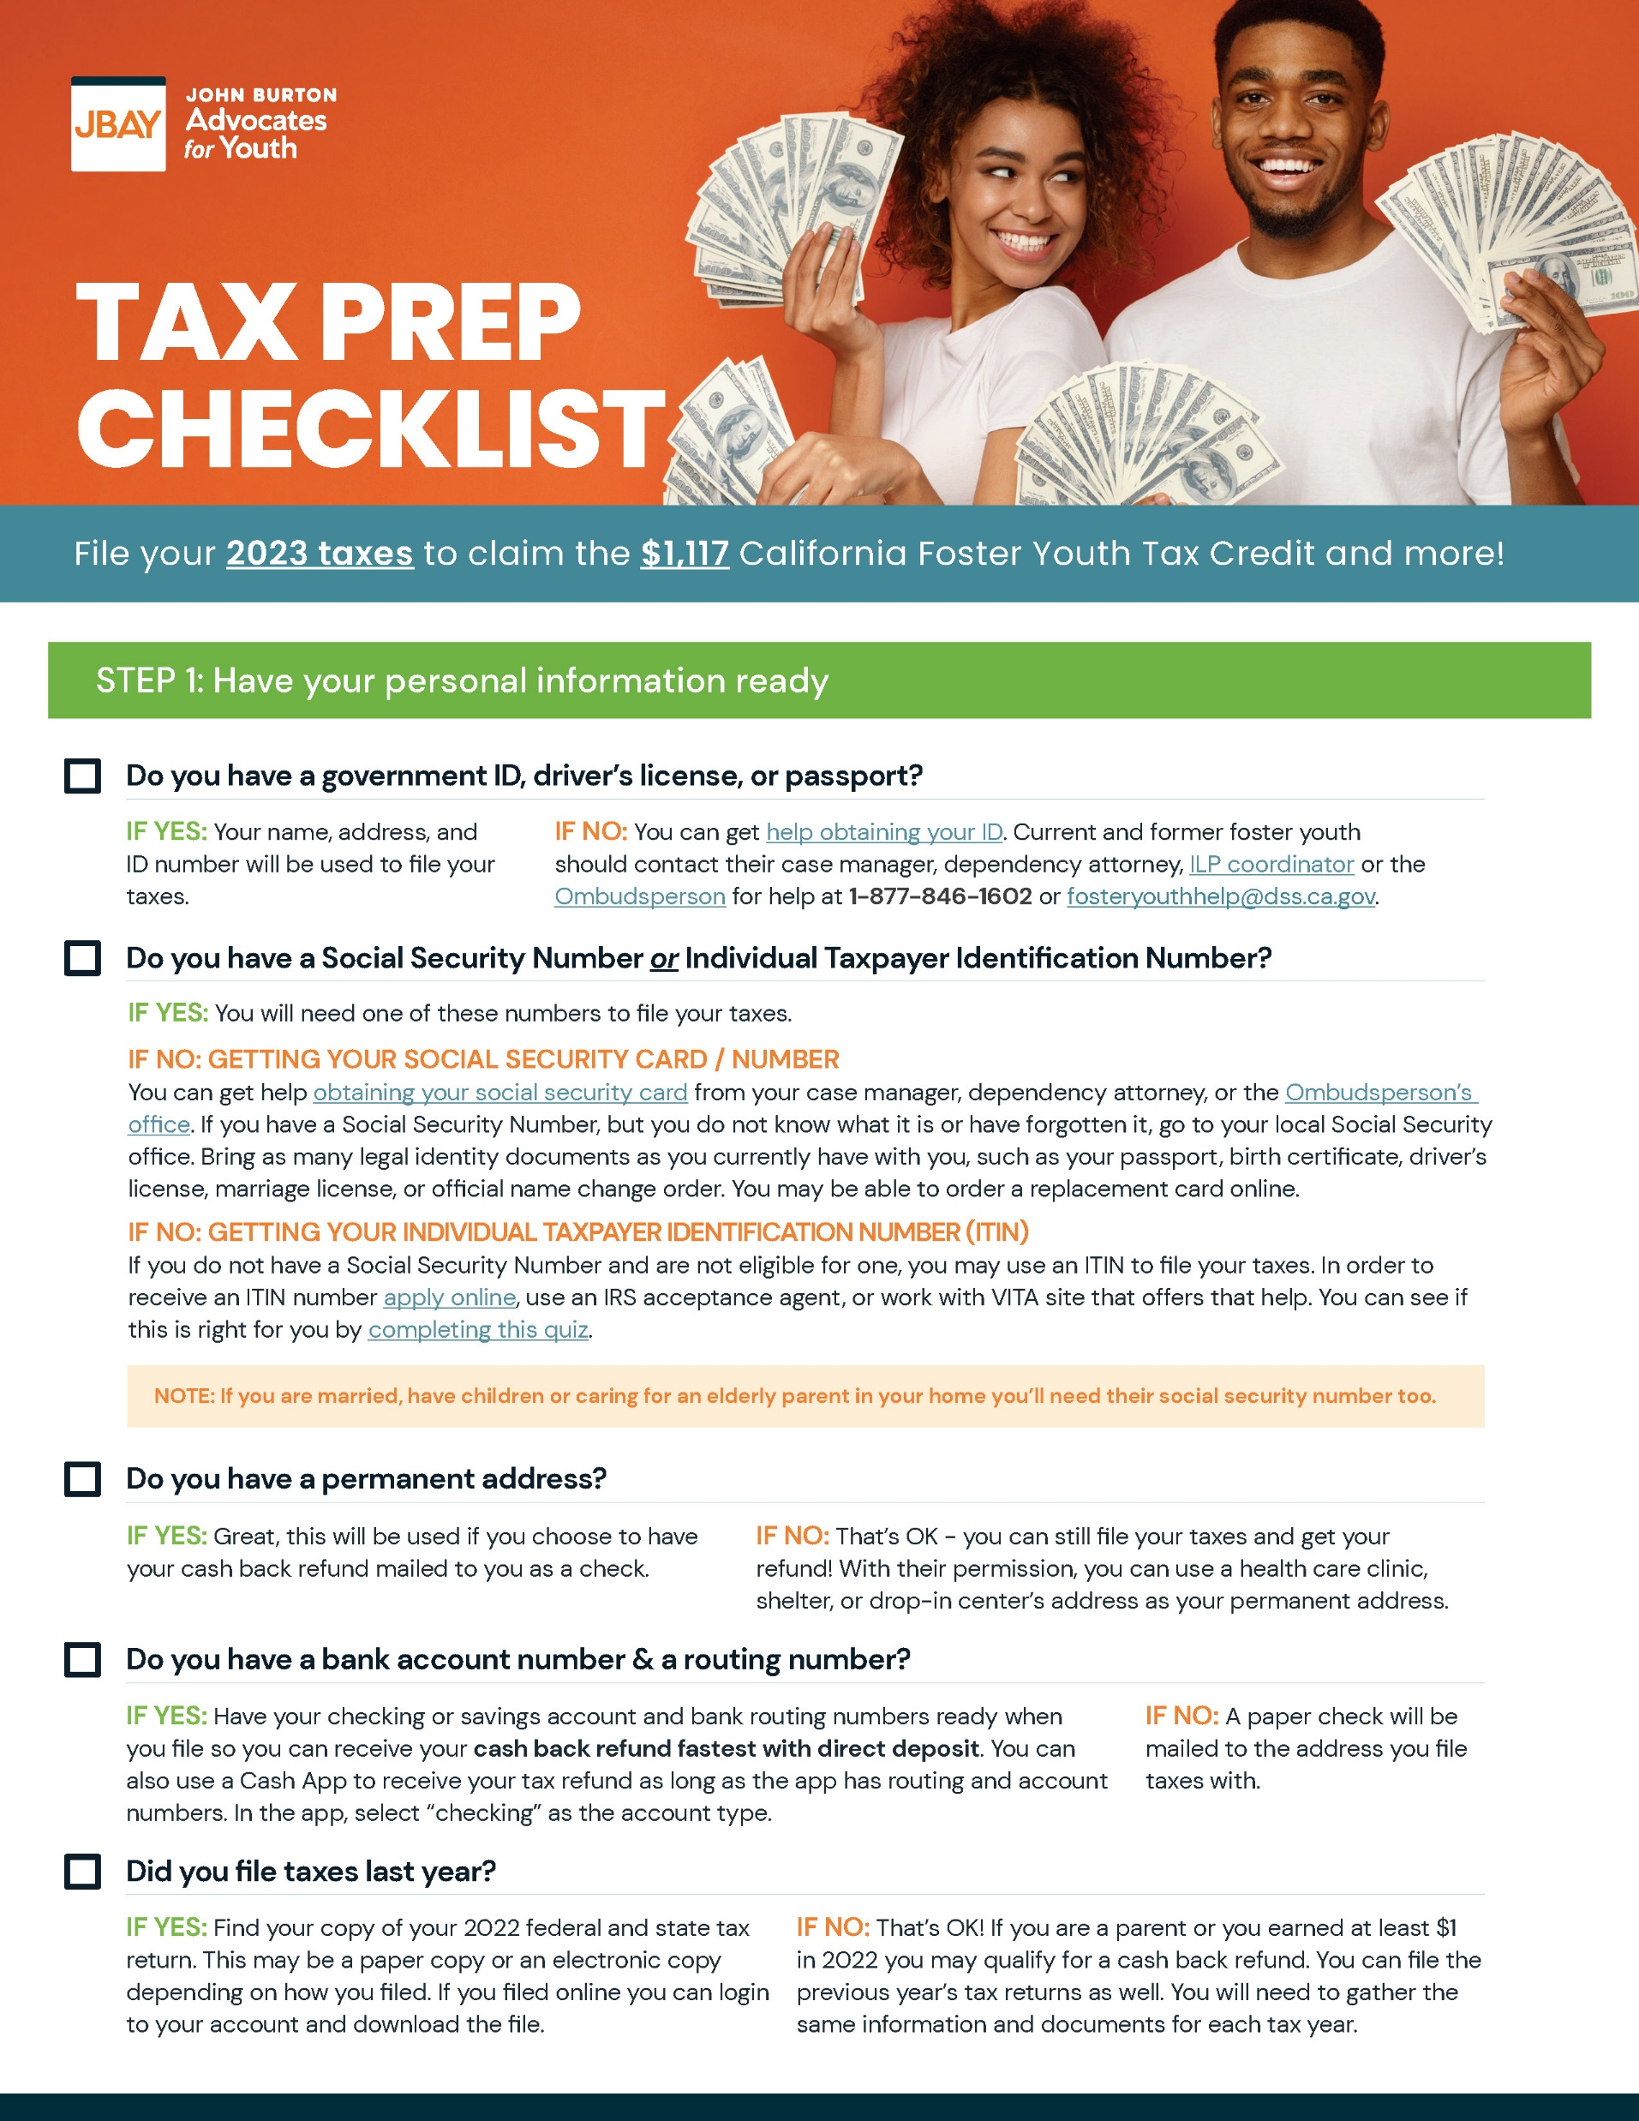
The Tax Prep Checklist Will Tell You How to Prepare for Filing Your Taxes.
You can download it here: https://jbay.org/resources/tax-prep/

Slide 16
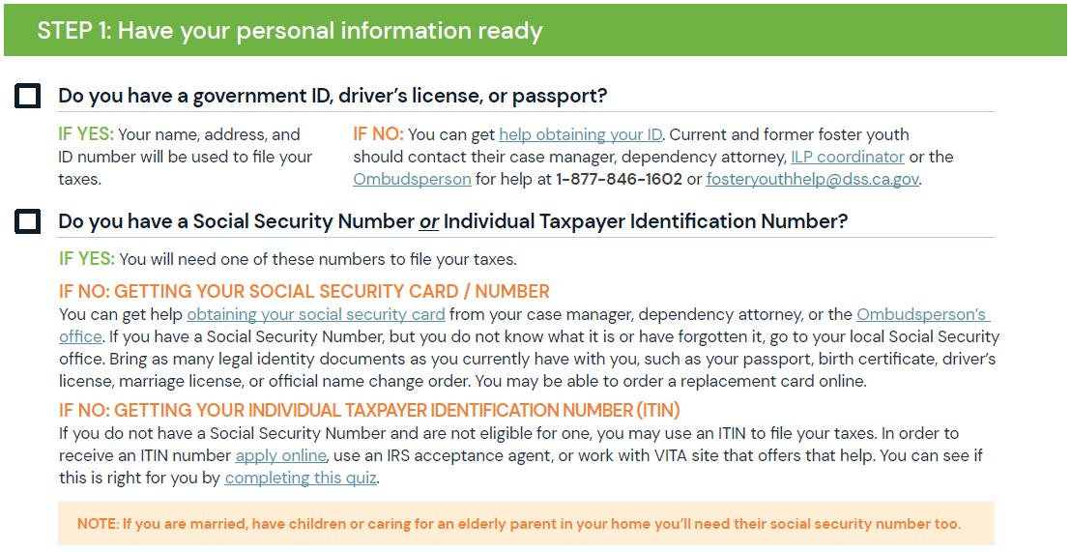
Notes:
Notes:
You can get help obtaining your ID. Current and former foster youth should contact their case manager, dependency attorney, ILP coordinator or the Ombudsperson for help at 1-877-846-1602 or fosteryouthhelp@dss.ca.gov.

Slide 17
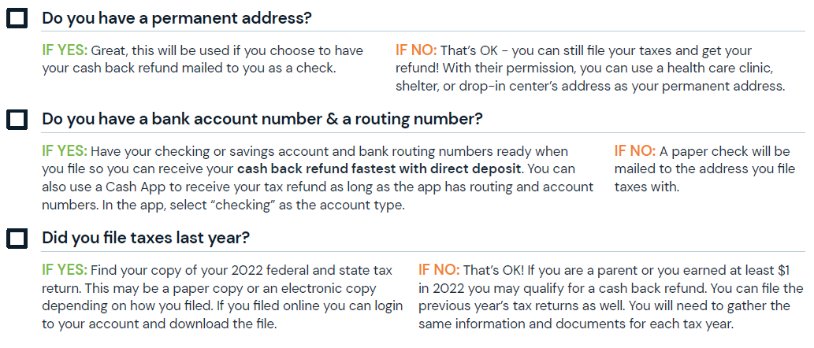

Slide 18
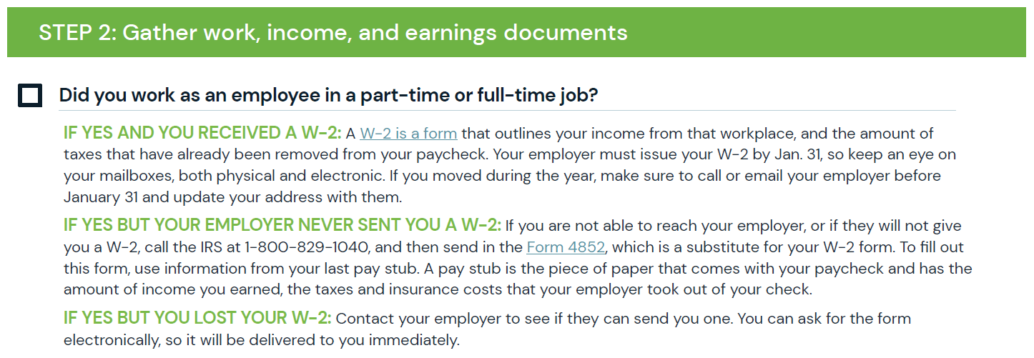

Slide 19
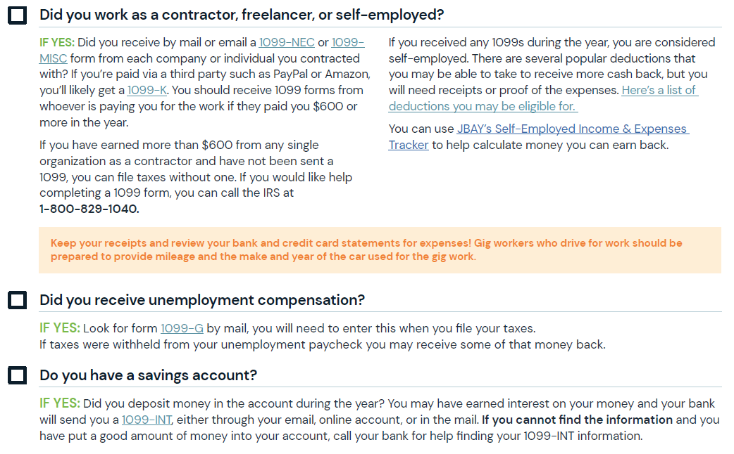
Notes:
Note for Trainer:
Monthly foster care payments, infant supplement payments, Expectant Parent Payments, guaranteed income payments, grants and scholarships spent on qualified education expenses, and student loans are NOT taxable income and should not be reported on taxes.
Self Employment Tips (may want to have this conversation one-on-one if very few attendees are self-employed in the group):
With self-employment, no taxes are taken out of your paycheck throughout the year.
You should set aside about 30% of your earnings throughout the year so that you can use that money to pay your taxes come tax time.
If you receive cash income, obtain a letter from your employer stating how much you are paid for your service, especially if over $600.
Keep track of all work-related expenses (i.e. mileage if you drive for work, business insurance, office supplies, phone and internet, etc.). If it is a personal phone you use for business, think about the percentage of time you use the phone for business.
Notes on mileage: You cannot claim mileage for driving from home to work or work to home. Business miles are miles related to the business activity that aren’t commuting miles. For example, for-hire drivers who pick up customers can claim that mileage as a business expense. You will need a description of the vehicle uses for business (year, make, model). The standard mileage deduction includes depreciation, gas/oil, repairs, insurance, and the nontaxable portion of vehicle registration. It does not include parking or tolls. Keep a written record.

Slide 20
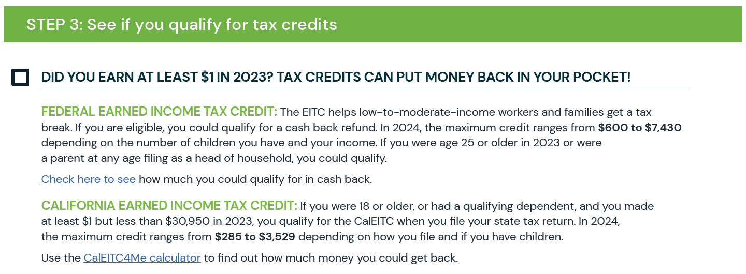

Slide 21
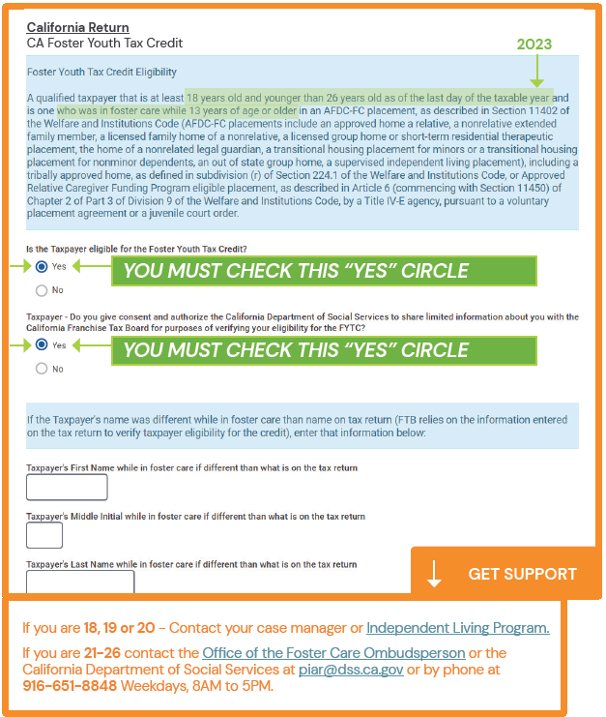
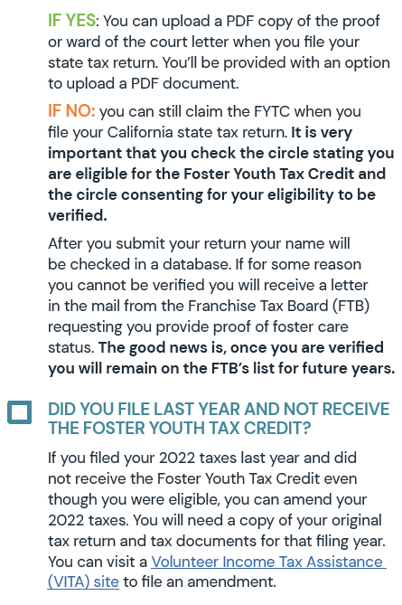
Notes:
If you are self-filing, you must check the box indicating you consent to eligibility verification. To date, there have not been problems with the eligibility process utilization by the Franchise Tax Board and the Department of Social Services. However, if you want to be extra sure you are verified with no issues, you can optionally upload a dependency letter.
Trainer: Consider putting a slide up with the ILP coordinator’s contact information so that youth know how to request a dependency letter in your county. For former foster youth, they can contact the California Department of Social Services: (916) 651-8848 or piar@dss.ca.gov
Dependency letters for youth who are parenting should also include the name and DOB for their children and the number of days during the tax year that their child(ren) were in their care.

Slide 22
Notes:
Additional information for college students:
Qualified education expenses that are tax free include: Tuition and fees required to enroll at or attend an eligible education institution, course related expenses such as fees, books, supplies (pens/paper), equipment that is required for courses. In addition this can include laptops/chromebooks, and computer software.
Non-qualified education expenses include: Room and board (including dorms), student health fees, cafeteria food card, research, equipment and other expenses not required for enrollment, travel, and clerical help. If grants or scholarships are used for non-qualified expenses, the money is taxable.

Slide 23
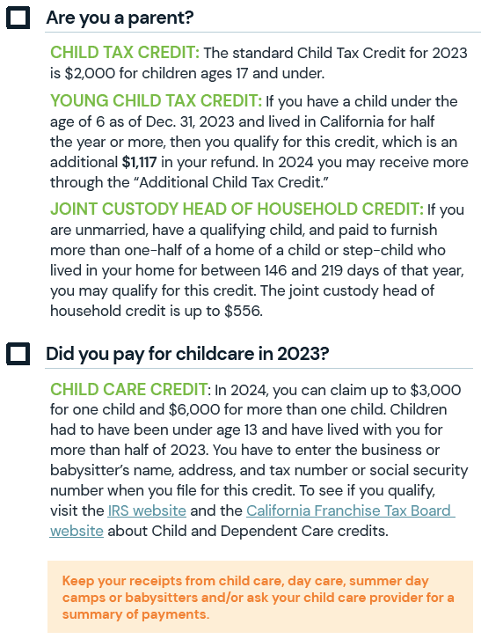
Notes:
Additional information for parenting youth:
Who can claim YOUR child(ren) on their taxes? The person they lived with/who provided care for them for more than half of the tax year. (If they lived with a foster parent or relative for more than half the year, this person can claim them).
If you share custody with your child(ren)’s other parent, you two should discuss who will claim the child(ren) on their taxes.
Two different taxpayers cannot claim the same dependent (if you are married and you two file together you can claim your child(ren) on your joint tax return but this is because its one tax return).
If two people claim the same child, the second person to claim them will receive an error code when e-filing. If the other person claimed your child when they should not have, you will likely be required to provide proof that your child0ren) were in your care during the tax year. It is best to communicate about this before hand and avoid this experience.

Slide 25
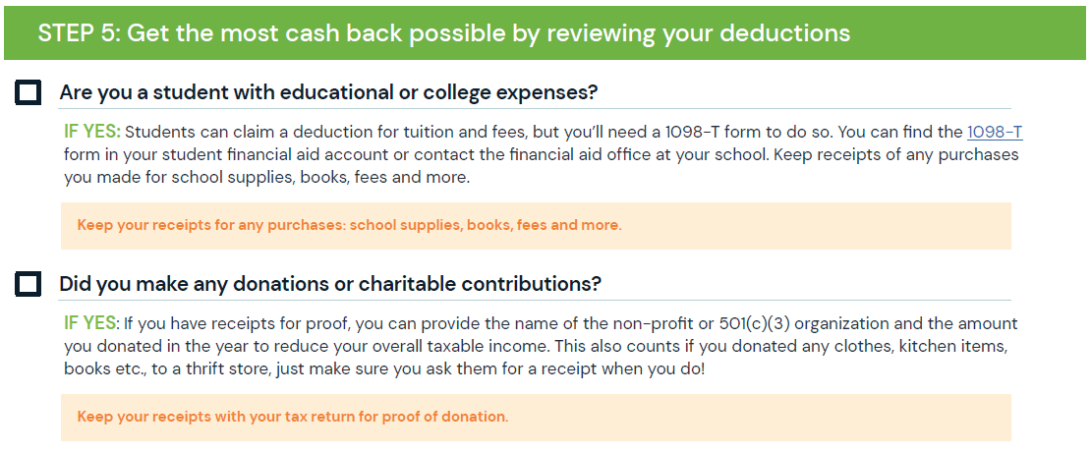
Notes:
Intro:
Deductions can reduce the amount of your income before you calculate the tax you owe.

Slide 26
How Do I File My Taxes?

Slide 27
There are Three Main Ways to File Your Taxes
Self-File
FREE if you use a free site
File with Assistance from an IRS-Certified Volunteer
FREE
File with a Paid Preparer
COSTS – not recommended
Notes:
The next slides will cover each option in more detail.

Slide 28
Self-Filing
This is the most common way to file for young adults.
File for free at myfreetaxes.org
**JBAY will circulate an updated self-filing guide that walks you through this process screen by screen**
You can also self-file using Turbo Tax, etc. but unless you get the free version, you will pay for these programs.
Don’t miss the Foster Youth Tax Credit! Make sure you select the correct boxes on their state tax return to receive it.
Notes:
Additional information:
There may also be self-filing events in your area where someone is available if you get stuck while you’re filing. (Trainer: If you intend to hold a self-filing event, we recommend adding information in this section about the event).

Slide 29
File With Assistance from an IRS-Certified Volunteer
Volunteer Income Tax Assistance (VITA) Sites offer free, one-on-one tax return preparation to people who earn $60K or less.
IRS-certified volunteers do the tax preparation.
There are not enough VITA sites to serve all eligible individuals (not even close). There are “VITA deserts” in some regions of the state.
Some VITA sites offer remote assistance.
Locate a VITA site for foster youth or a general VITA site using this roster: https://jbay.org/resources/fy-vita-sites/. If you use a general site make sure you bring info with you about the FYTC.
Notes:
Additional information:
In some counties there are sites specifically for current and former foster youth. Trainer: Look into this prior to the workshop and make sure you have information on this site handy. Here is the roster of sites: https://jbay.org/resources/fy-vita-sites/ - note this will be updated closer to tax season as sites prepare to re-open.
VITA sites not specialized to serve foster youth may not be aware of the Foster Youth Tax Credit. Youth should bring a one-pager with them about the credit. JBAY will provide this for the 2024 tax season.

Slide 30
Paid Preparers: Proceed with Caution
Why shouldn’t I use a paid preparer to file my taxes?
They miss the Foster Youth Tax Credit: In 2023 just 5% of FYTC recipients filed with a paid preparer vs. 57% of CalEITC recipients.
Upwards of 60% of paid preparers make errors on tax returns.
Some paid preparers use predatory practices (e.g. refund advancements w/ interest).
If they miss a credit, you will have to pay again for the preparer to amend (correct and re-file) your taxes.
If you choose to use a paid preparer:
Take information about the Foster Youth Tax Credit to ensure they don’t miss it.
If they miss the FYTC or other credits, you can amend your taxes at a VITA site for free.

Slide 31
Which Filing Method is Right for Me?
Self-Filing may be right for you if:
You’ve filed before
You’re pretty good at doing things independently and following written guidance
Your tax situation is pretty simple (no self-employment/gig work, no identify theft)
Filing at a VITA site may be right for you if:
You’re experiencing identity theft/you’re a victim of tax fraud
You have a complicated tax situation (e.g. have self-employment/gig work income, etc.)
You’re really nervous about filing and want one-on-one support
(Filing with a paid preparer is not recommended).
Notes:
You CAN self file up to three years prior, BUT at a VITA site you can do up to four years prior, so if youth did not receive their 2020 stimulus payment, this is the last year they can do it and they have to do it via a VITA site through paper filing.

Slide 32
What Happens After I File My Taxes?

Slide 33
What if I Uncovered Identity Theft While Filing?
What do you mean by identity theft/tax fraud?
Someone claims you as a dependent on their tax return that shouldn’t.
Someone steals your Social Security Number to try to claim your stimulus payments or credits and direct to their bank account.
Who is legally allowed to claim me as a dependent?
Someone can claim you as a dependent if they provided at least half of your support for the tax year. If they are your foster parent or family, there are additional rules that apply. Trainer will explain.
If someone claims you that did not provide this, that is tax fraud.
Notes:
Note: There are additional rules to claiming someone as a dependent when they are your child, so this is important for any young adults being claimed by a bio parent, foster parent or other family.
When you’re claiming a dependent who is a child, there are further requirements:
The child has to have lived with you for at least half of the year.
The child must not have provided more than half of his or her own support for the year.
The child has to be related to you as a son, daughter, stepchild, foster child, brother, sister, half-brother, half-sister, stepbrother, stepsister, or a descendant of any of those.
The child must be 18 or younger at the end of the year, or under 24 if a student. To be a student, the child must have attended school full-time during at least five months of the year. The five months don’t have to be in a row. (However, age doesn’t matter if the child is totally and permanently disabled.)
The child must be younger than you (or your spouse, if married filing jointly).

Slide 34
How Do I Address Identity Theft?
Talk to your county child welfare agency:
Current nonminor dependents ► Seek assistance from your social worker or dependency attorney to resolve the issue.
Former foster youth ► Seek assistance from legal aid or check in with county child welfare agency about whether they can refer you to a specific organization addressing this for foster youth.
Resources:
Low Income Taxpayer Clinics (LITC) Taxpayer Advocate Services: https://www.taxpayeradvocate.irs.gov/about-us/low-income-taxpayer-clinics-litc/
If you’re in the Bay Area try Bay Area Legal Aid: https://baylegal.org/what-we-do/stability/
Notes:
Trainer: make sure and add a slide or alter this slide to include your county’s legal resources for identity theft. If unsure, you may want to seek guidance from your county’s dependency attorneys as to where to refer youth who experience identity theft/are victims of tax fraud.
More information on identity theft from the IRS: https://www.irs.gov/identity-theft-central

Slide 35
When to Amend a Return
Amending a tax return means correcting it and re-filing. You should do this when:
You forgot to enter a W-2
You chose the wrong filing status (i.e. single, head of household, etc.)
You did not claim the correct number of dependents
You discovered a credit or deduction you should have claimed
The amount of earned income you reported is incorrect
You received a form, such as a 1099 after you already filed your taxes
How do I amend my taxes?
You can do it yourself at myfreetaxes.org or if you used Turbo Tax you can do it there.
If you want support, visit a VITA site to amend your taxes but be sure to bring a copy of your original return and all tax documents.

Slide 36
Important Communications from the IRS or FTB
What if I get a letter from the IRS or Franchise Tax Board?
You must respond within 30 days!
This usually means the IRS need additional information to file your taxes (e.g. verification of foster youth status if the state match fails, verification that a child is in your care, verification of self-employment income, etc.)
Caution: The IRS sends letters. They DO NOT call, email, or connect through social media. Do not give out your Taxpayer Identity Protection Pin, bank account number, or Social Security Number.

Slide 37
Taxes Are Filed…Now What?
How do I check for my tax refund?
Federal: https://www.irs.gov/refunds
State: https://www.ftb.ca.gov/refund/index.asp
Note: e-filing takes 3-4 weeks; paper filing takes 6-8 weeks
How do I prepare for next year?
Save documents for next year!
Taxes from 2024, receipts for higher education and self-employment expenses, W-2s, etc.
It is recommended you keep records of 5 years of tax returns

Slide 38
Thank You

